Slide 1

Beginnings and Basic Rhetorical Considerations
Rhetorical Triangle

Slide 2
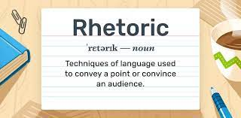
Rhetoric
Rhetoric: The art of persuasive speaking or writing.
Using language effectively to persuade.
Notes:
“the art of convincing audience that they should listen to, and be persuaded by the speaker’s/ writer’s argument through the arrangement, delivery, and style of his/her message.”
If you use it well, your audience will easily understand what you're saying, and will be influenced by your message.

Slide 3
Rhetorical Triangle
Aristotle in his book “Rhetoric” identified 3 persuasion methods by which people can be persuaded.
Considered together, these appeals form what later rhetoricians have called the rhetorical triangle.
ethos
pathos
logos

Slide 4
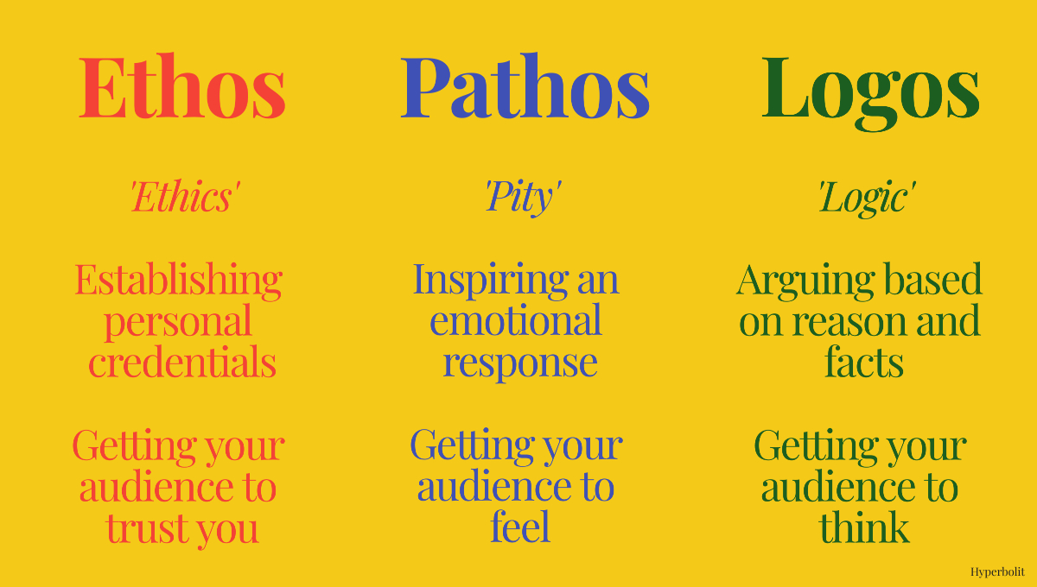
Ethos- Pathos- Logos
Notes:
Ethos: building trust by establishing your credibility and authority (Writer).
Pathos: appealing to emotion by connecting with your audience through their values and interests (Audience).
Logos: appealing to your audience's intelligence with well-constructed and clearly argued ideas (Context).

Slide 5
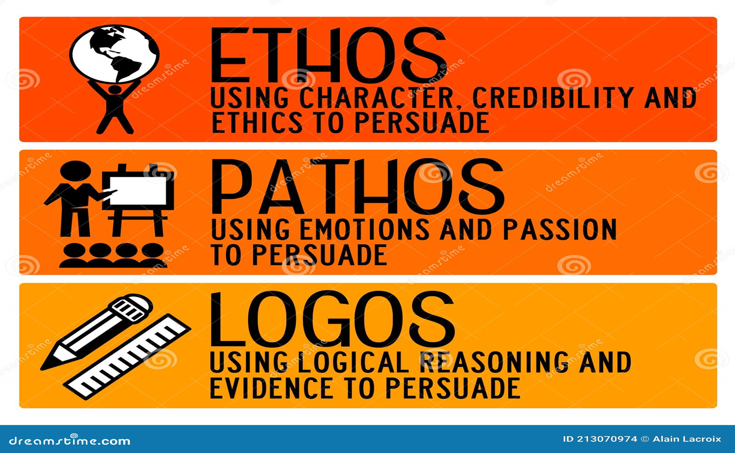

Slide 6
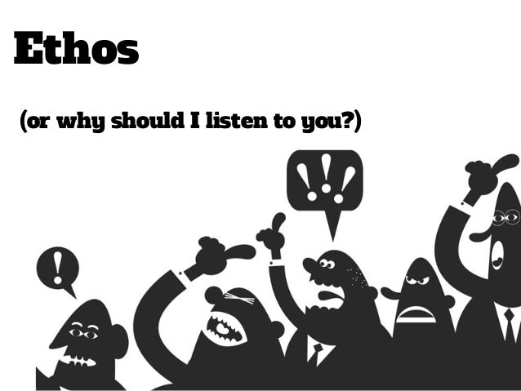

Slide 7
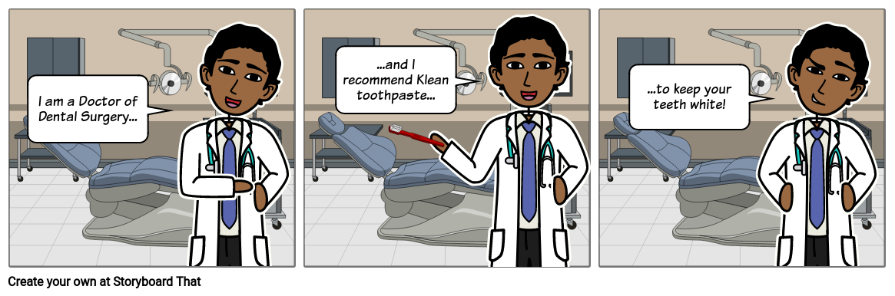
Ethos
Definition: the writer establishes credibility/trustworthiness
Is the author reliable and credible?
Is the author knowledgeable?
Demonstrate knowledge, experience, or expertise

Slide 8



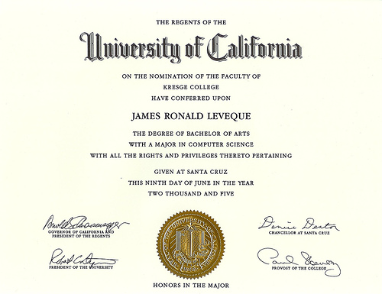



Ethos Example
Professional Degree/Recognition
Years of Experience

Slide 9
Ethos
Ethos is an appeal to ethics, and it is a means of convincing someone of the character or credibility of the persuader.
As a doctor, I am qualified to tell you that this course of treatment will likely generate the best results.“
"My three decades of experience in public service, my tireless commitment to the people of this community, and my willingness to reach across the aisle and cooperate with the opposition, make me the ideal candidate for your mayor.“
"The veterinarian says that an Australian shepherd will be the perfect match for our active lifestyle.“

Slide 10
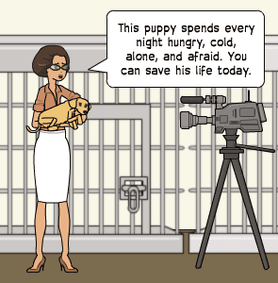
Pathos

Slide 11

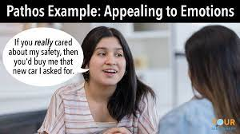
Pathos
Definition: the writer appeals to the emotions of the audience.
Pathos is an appeal to emotion, and is a way of convincing an audience of an argument by creating an emotional response.
Share personal/real anecdotes (stories)
Use word choice that makes people feel something
You may also use:
descriptive language
figurative language

Slide 12
Descriptive language is the art of using words and phrases to create detailed mental images, evoke emotions, and engage a reader's or listener's senses.
For example: Let’s help the children VS Let’s help the pity, starving, dying children
Figurative language refers to the use of words in a way that deviates from the conventional meaning in order to convey the meaning.
For example: Your RM1 is like a heaven to them

Slide 13
Example
Pathos is an appeal to emotion, and is a way of convincing an audience of an argument by creating an emotional response.
Let us help the poor, starving kids NOW!
"This slimming pills will help you to reduce your weight in 3 months! No exercise needed! No diet-plan needed!”
"You make a right decision by donating to this charity because you have something that not many people do: you have heart."

Slide 14

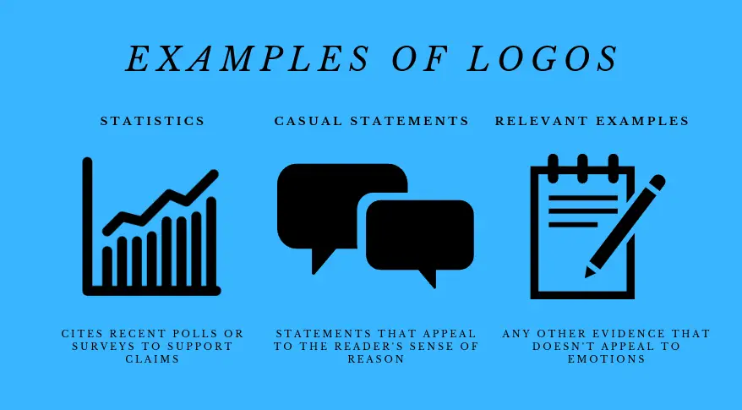
Logos
Definition: the writer appeals to the audience’s sense of logic.
Provide examples, facts, or statistics
Include Expert Testimonies

Slide 15
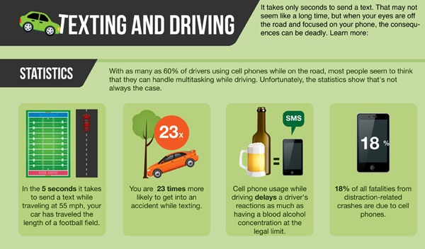
Logos
Percentages/Amounts
Real Examples
Quoting Expert Insight
“According to…”

Slide 16
Example
Logos is an appeal to logic, and is a way of persuading an audience by reason.
"The data is perfectly clear: this investment has consistently turned a profit year-over-year, even in spite of market declines in other areas.“
"Ladies and gentlemen of the jury: we have not only the fingerprints, the lack of an alibi, a clear motive, and an expressed desire to commit the robbery… We also have video of the suspect breaking in. The case could not be more open and shut.“
“According to Johnson (2024), more than one hundred peer-reviewed studies have been conducted over the past decade, and none of them suggests that this is an effective treatment for hair loss."

Slide 17
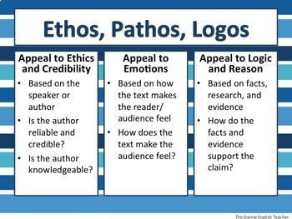
Notes:
Ethos-Writer
Pathos-Audience
Logos-Context-audience will analyze your message by putting it into context

